Slide 1
Mastering
Communications
PRESENTED BY: MALIA ROGERS
Communication Hacks
for Insurance Agents

Slide 2
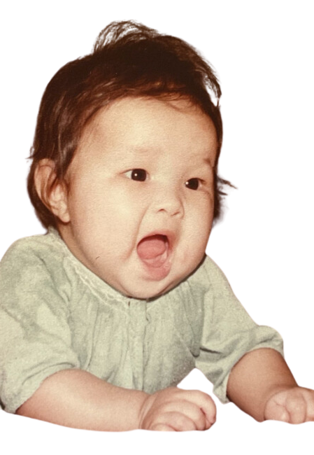
My Embarrassing
Story

Slide 3
PERSONAL BRANDING
CLIENT
RELATIONSHIPS
COMMUNICATION
SKILLS
STAND OUT
FROM COMPETITION
ELEVATE
CONNECTIONS

Slide 4
HOW YOU SAY IT
WHAT YOU SAY
BODY
LANGUAGE
Anatomy of Communication
ACTIVE LISTENING
FEEDBACK
LOOP

Slide 5
ACTIVE LISTENING
TRAFFIC LIGHT RULE
Notes:
*Practice listening skills
*Be present
*1 minute traffic light rule (first 30 seconds you talk, second 30 seconds wrap up, stop after 1 minute)

Slide 6
WHAT YOU SAY
Master Story Telling
Facts VS Stories
A story is a FACT
Wrapped in EMOTION
That compels us to take ACTION

Slide 7
HOW YOU SAY IT
TONE
PITCH & INFLECTION
SOUND
Notes:
*Our voice: Influences how people view you, unique & distinct, a musical instrument
*Words only account for 7%...tonality counts for more than 38%
*Avoid monotone
*Ascending vs Descending (texts & emails can be misunderstood)
*Voice Audit (Nasally, monotone, airy?)
*Vocal Exercise for a deeper & richer tone

Slide 8
BODY
LANGUAGE
Build Charisma

Slide 9
BODY
LANGUAGE
Build Charisma
COMPETENCE
WARMTH

Slide 10
Build Charisma
BODY
LANGUAGE
Continued
warm
charisma
zone
warmth
danger
zone
competent
competence

Slide 11
Build Charisma
BODY
LANGUAGE
Continued
COMPETENCE | WARM
Impressive | Trustworthy
Powerful | Collaborative
Smart | Kind
Capable | Compassionate
An Expert | A Team Player
Effective | Open

Slide 12
Build Charisma
BODY
LANGUAGE
Continued
WARMTH QUES | COMPETENCE QUES
SMILE | SHARE KNOWLEDGE
ENCOURAGE | BE PREPARED
EYE CONTACT | PROBLEM SOLVE
BODY LANGUAGE | COMMUNICATE EFFECTIVELY
VERBAL | MAINTAIN POSTURE

Slide 13
Build Charisma
BODY
LANGUAGE
Continued
vs

Slide 14
FEEDBACK
LOOP
Feedback

Slide 15
Practice Improv
ACTIVE LISTENING
CREATIVITY & INNOVATION
ADAPTABILITY
COLLABORATION

Slide 16
Bonus
Scan this for a list of characteristics that make a person magnetic!

Slide 17
The End!
Malia@CustomizeYourInsurance.com
facebook.com/malia.rogers

