Slide 1
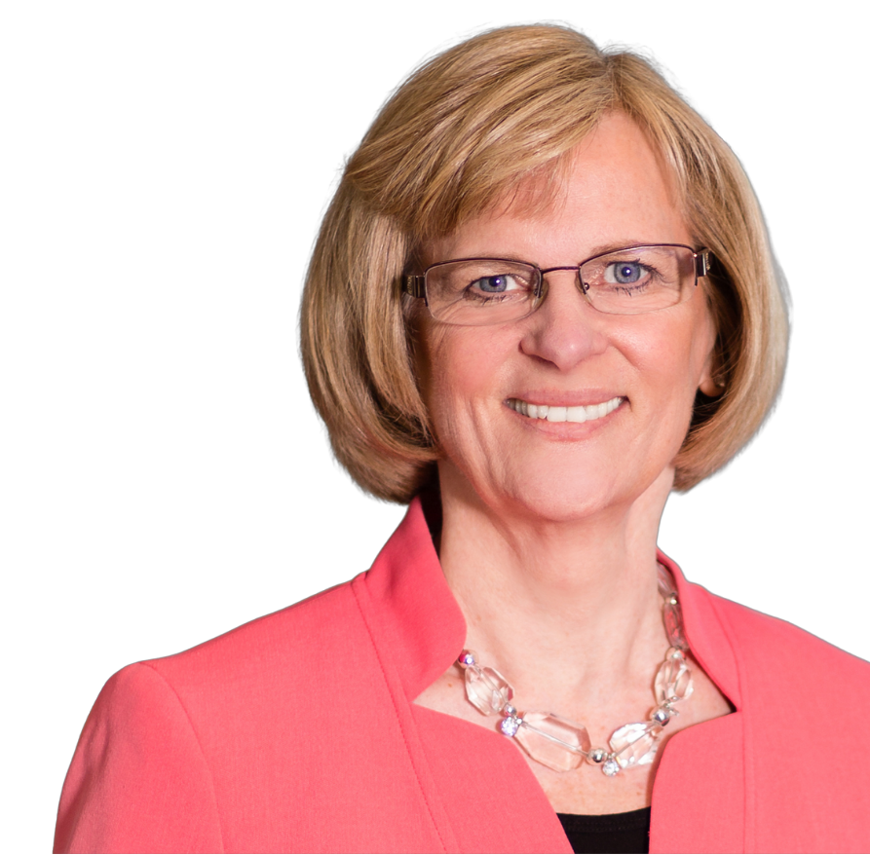
Build Credibility for Self and Trust & Accountability in Teams
Connie Miller
CEO & Author

Slide 2
Gaps in Executive-Level Skills
Top 5 Gaps in Executive and Board Leadership Skills
Emotional Intelligence & Awareness
Courageous & Crucial Conversations
Critical and Strategic Thinker
Succession Planning & Delegation
Leading with Consistent Voice as One Executive Team
Leadership = We > Me

Slide 3
Building Trust and Accountable Teams
The Theory of the Herd
By Eric Coryell
Humans are pack animals
Individual action is a myth
Connection to a group is a requirement for human survival

Slide 4
Building Trust and Accountable Teams
Five Basic Human Fears
There are only five basic fears. Our so-called fears are manufactured here.
Extinction—the fear of annihilation, of ceasing to exist.
Mutilation—the fear of losing bodily structure; body's boundaries invaded, or integrity of a body part.
Loss of Autonomy—the fear of being immobilized, paralyzed, restricted, overwhelmed, etc.
Ego-death - humiliation, shame, etc.
Separation—the fear of abandonment, rejection, and loss of connectedness; of becoming a non-person—not wanted, respected, or valued by anyone else. The "silent treatment," when imposed by a group, can have a devastating psychological effect on its target.

Slide 5
Building Trust and Accountable Teams
What Happens to Anxiety, Fear of
Separation, and Trust as We Engage in Each Behavior?
Ignore it / Avoid it / Do Nothing
Anxiety: Fear of Separation: Trust:

Slide 6
Building Trust and Accountable Teams
What Happens to Anxiety, Fear of
Separation, and Trust as We Engage in Each Behavior?
Ignore it / Avoid it / Do Nothing
Anxiety: Fear of Separation: Trust:
2) Talk Behind Their Back
Anxiety: Fear of Separation: Trust:

Slide 7
Building Trust and Accountable Teams
What Happens to Anxiety, Fear of
Separation, and Trust as We Engage in Each Behavior?
Ignore it / Avoid it / Do Nothing
Anxiety: Fear of Separation: Trust:
2) Talk Behind Their Back
Anxiety: Fear of Separation: Trust:
3) Look to the Leader/Boss/Rescuer to Take Care of It
Anxiety: Fear of Separation: Trust:

Slide 8
Building Trust and Accountable Teams
What Happens to Anxiety, Fear of
Separation, and Trust as We Engage in Each Behavior?
Ignore it / Avoid it / Do Nothing
Anxiety: Fear of Separation: Trust:
2) Talk Behind Their Back
Anxiety: Fear of Separation: Trust:
3) Look to the Leader/Boss/Rescuer to Take Care of It
Anxiety: Fear of Separation: Trust:
90% Happens Here

Slide 9
Building Trust and Accountable Teams
What Happens to Anxiety, Fear of
Separation, and Trust as We Engage in Each Behavior?
Ignore it / Avoid it / Do Nothing
Anxiety: Fear of Separation: Trust:
2) Talk Behind Their Back
Anxiety: Fear of Separation: Trust:
3) Look to the Leader/Boss/Rescuer to Take Care of It
Anxiety: Fear of Separation: Trust:
4) One-On-One Conversation
Anxiety: Fear of Separation: Trust:

Slide 10
Building Trust and Accountable Teams
What Happens to Anxiety, Fear of
Separation, and Trust as We Engage in Each Behavior?
Ignore it / Avoid it / Do Nothing
Anxiety: Fear of Separation: Trust:
2) Talk Behind Their Back
Anxiety: Fear of Separation: Trust:
3) Look to the Leader/Boss/Rescuer to Take Care of It
Anxiety: Fear of Separation: Trust:
4) One-On-One Conversation
Anxiety: Fear of Separation: Trust:
5) Group Conversation
Anxiety: Fear of Separation: Trust:

Slide 11
Building Trust and Accountable Teams
What Happens to Anxiety, Fear of
Separation, and Trust as We Engage in Each Behavior?
Ignore it / Avoid it / Do Nothing
Anxiety: Fear of Separation: Trust:
2) Talk Behind Their Back
Anxiety: Fear of Separation: Trust:
3) Look to the Leader/Boss/Rescuer to Take Care of It
Anxiety: Fear of Separation: Trust:
4) One-On-One Conversation
Anxiety: Fear of Separation: Trust:
5) Group Conversation
Anxiety: Fear of Separation: Trust:

Slide 12
Commitment to Improve Accountability and Trust
Don’t hide behind a question when you are really making a statement.
Request owners of problem to consistently identify the “they” or “everyone” or groups, such as “all the branches” or “all our partners”. Own it.
Don’t hide behind company-wide or broad emails.

Slide 13
No Pairing Code of Conduct
Commit to each other that ‘pairing off’ will not occur. Establish a No Pairing Code of Conduct.
Pause all conversations if that person is not in the room.
Reschedule conversations when all can attend. Shuts down gossip and negativity.

Slide 14
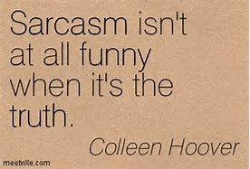
Insecurity. For some, using sarcasm or teasing is a way of avoiding confrontation because they are afraid of asking for what they want.
Sarcasm can also be passive aggressive or as a way to assert dominance.
Social Awkwardness. This is another kind of insecurity, but you will often hear loners at parties or networking events use sarcasm as an attempt to lighten the mood or bond.
Misunderstandings in sarcasm are by design. Address with the Genuine Approach of confirmation.
https://www.scienceofpeople.com/sarcasm-why-it-hurts-us/

Slide 15
RESISTANCE BRAIN vs. RECEPTIVE BRAIN
Brainstem
Fight or Flight
Source: Bill Crawford “Top of the Brain”

Slide 16
Creating Success:
Retrain the limbic system to see stress for what it is, which is not something that is being done TO us (deadlines/difficult people). Emotions are housed here.
Recognize that stress is a chemical change and signals data to be sent to the lower 20% of our brain
Get to “The Top of the Brain.” 80% of the brain is the Neocortex.

Slide 17
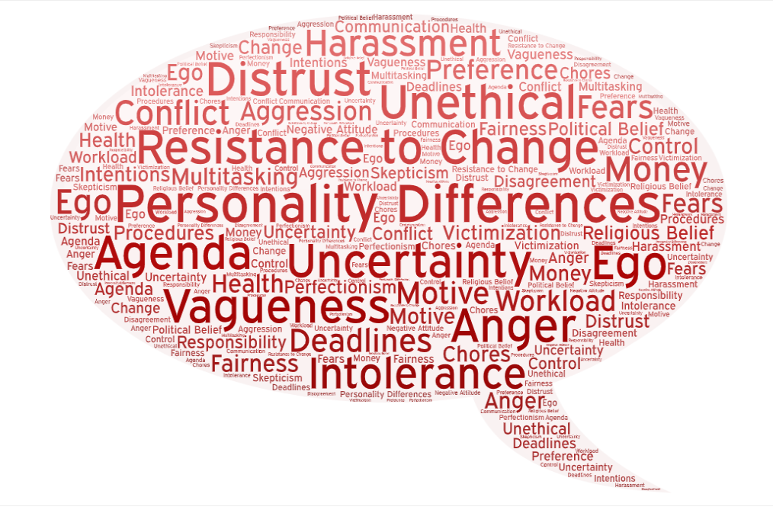
Know YOUR Top Triggers
1.
2.
3.
4.
5.

Slide 18
Neocortex Questions by Bill Crafword
Ask these questions to engage upper part of brain.
Has this thought, emotion, or action been chosen deliberately, or on purpose?

Slide 19
Neocortex Questions by Bill Crafword
Engagement of Upper 80% of brain is required:
Has this thought, emotion, or action been chosen deliberately, or on purpose?
How is it working for me? Is it getting me what I want?

Slide 20
Neocortex Questions by Bill Crafword
Engagement of Upper 80% of brain is required:
Has this thought, emotion, or action been chosen deliberately, or on purpose?
How is it working for me?
Is this thought, emotion, or action making the statement I want to make about who I am?

Slide 21
Neocortex Questions by Bill Crafword
Engagement of Upper 80% of brain is required:
Has this thought, emotion, or action been chosen deliberately, or on purpose?
How is it working for me?
Is this thought, emotion, or action making the statement I want to make about who I am?
Would I teach this thought, emotion, or reaction to my child,
my children or to someone I love?

Slide 22
Shut Down the Drama Zone!
Persecutor
Drama
Victim
Rescuer
Reference: Abe Wagner

Slide 23
Shutting Down the Drama Zone
Shift your focus to help the victim own the problem and solve it themselves.
Offer questions instead of advice.
And then wait 30 seconds for them to process and respond.
Persecutor
Drama
Victim
Rescuer

Slide 24
Shutting Down the Drama Zone
Provide questions for the victim so they can begin to process and solve the problem through your questions.
All questions should include “what” and “you”.
Avoid “I” and “should”.
What can you do to better understand the complete situation?
What can you do so your boss better understands your concerns?
What can you do to avoid hurting your reputation?
What will it take to ensure you have an opportunity to succeed?
What are your choices, and do they support what you are trying to accomplish?
What problem are you trying to solve?
Persecutor
Drama
Victim
Rescuer

Slide 25
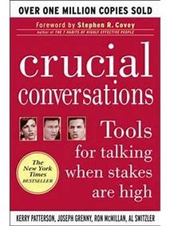
Master Crucial Conversations
The easiest way to keep a secret is without help. ~Author Unknown
Whoever gossips to you will gossip about you. ~Spanish Proverb
Do not repeat anything you will not sign your name to. ~Author Unknown
It isn't what they say about you, it's what they whisper. ~Errol Flynn

Slide 26
Investing in culture will drive financial results & profitability.

Slide 27
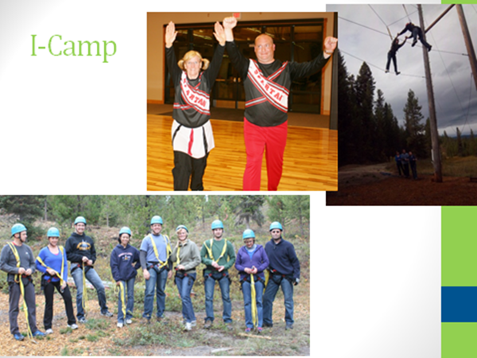
MOVE YOUR ORGANIZATION & TEAM FORWARD
Icon CU ranked #7 from more than 5,400 credit unions for healthiest credit unions in the country
Culture of fun & accountability

Slide 28
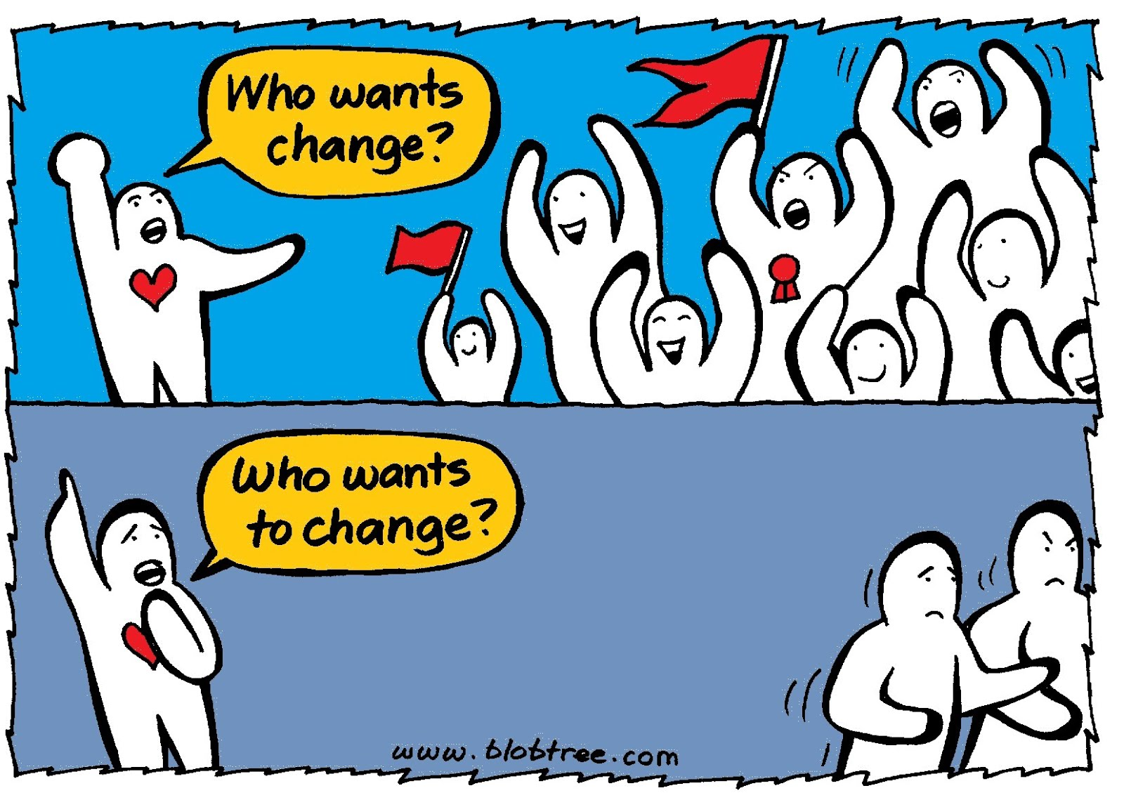
Be A Part of the Change!

Slide 29
Connie@CredibleAdvantage.com
208-866-8449
Connie Miller
Connie Miller
CEO, Founder & Author
CEO, Founder & Author

